Slide 1
PPKS projekt
Student: Boris Boronjek
JMBAG: 0036531473

Slide 2
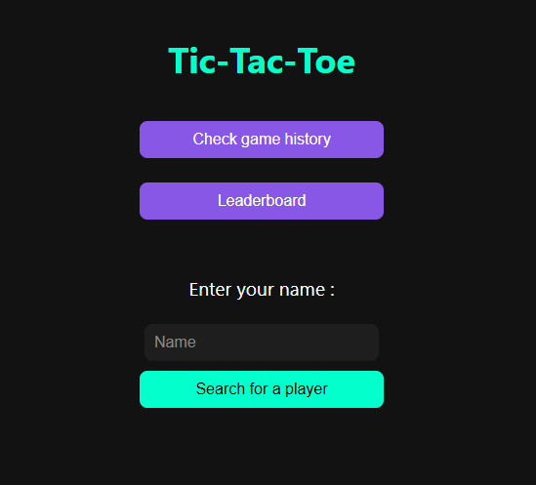
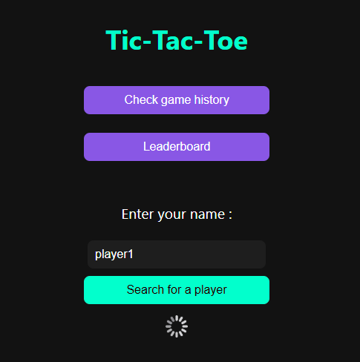
Index.html

Slide 3
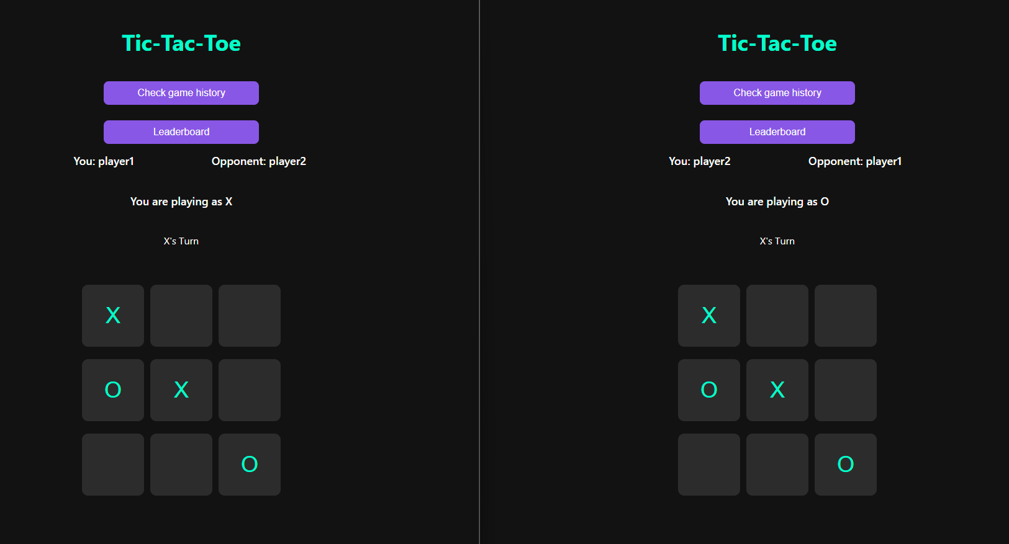
Index.html

Slide 4
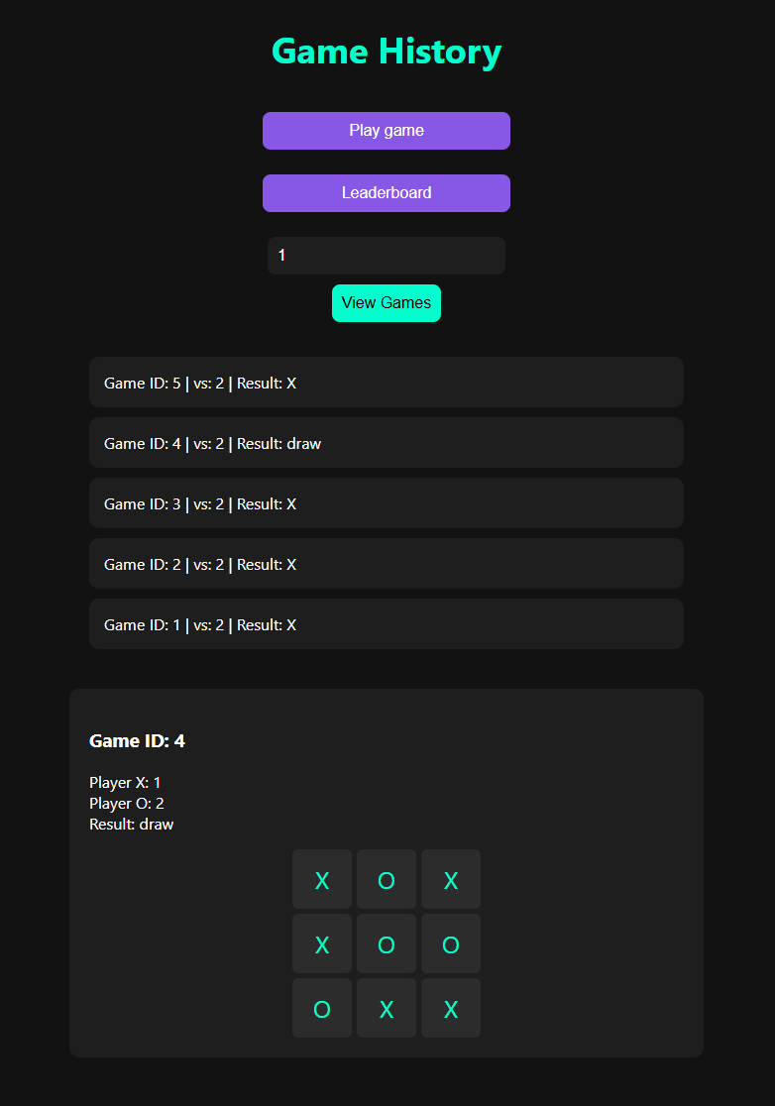
game_history.html

Slide 5
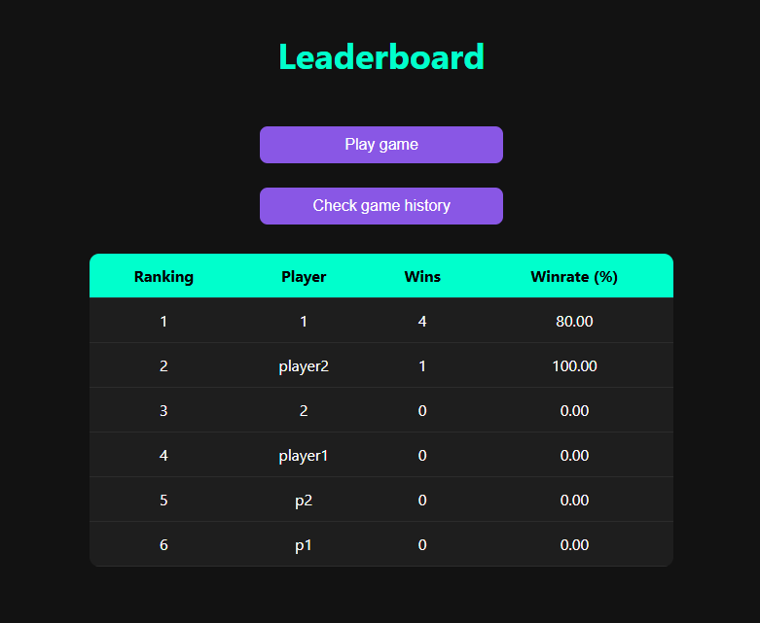
leaderboard.html

Slide 6
Hvala na pažnji!

